Slide 1
Architecture & Basic Web Procedure
DNS Hijacking, Information Disclosure, Plaintext Transmission

Slide 2
Rough Overview
Introduction
Basic Principles and Resources
>> Architecture & Basic Web Procedure <<
Authentication and Session Management
Authorization
Server and Backend Attacks
Remaining Client Attacks
General Topics
Conclusions

Slide 3
How does the typical architecure of a web application look like?

Slide 4












Slide 5
How do you access a website?
(except for googling it...)
You enter a URL
Uniform Resource Locator
and hit enter…
http://example.com:8080/demos/demo1.html?id=123&name=Luke#ref1
Protocol
Hostname
Port
Path
Query / Parameters
Fragment

Slide 6
What‘s next ?

Slide 8


http://example.com:8080/demos/demo1.html?id=123&name=Luke#ref1

Slide 9
You already know DNS
What can go wrong?

Slide 10
DNS Hijacking | SQL Injection
Goal | Redirect user to a rogue server by manipulation of DNS records
How
Solution
OWASP Top 10
(Primary) Violated Principle
Notes:
Is used by
- ISPs to display advertisement or collect statistics
Some Captive Portals for logon page
http://labsdetectify.wpengine.com/2014/10/21/hostile-subdomain-takeover-using-herokugithubdesk-more/

Slide 11
DNS Hijacking | SQL Injection
Goal | Redirect user to a rogue server by manipulation of DNS records
How | Malware on client DNS server attack, e.g. DNS spoofing / cache poisoning MitM between client and DNS server Subdomain takeover
Solution
OWASP Top 10
(Primary) Violated Principle
Notes:
Spoofing / cache poisoning:
- Attacker floods a requesting caching DNS Server
-> Caching server thinks the faked response is real, based on
=>It comes back to the same IP it was sent from
=> It comes back to the same port number it was sent fro
=> The answer matches the question asked
=> A unique transaction identifier matches what was sent
==> Guessing this one is the challenge
http://labsdetectify.wpengine.com/2014/10/21/hostile-subdomain-takeover-using-herokugithubdesk-more/
https://www.golem.de/news/subdomain-takeover-verwaiste-domains-einfach-uebernehmen-1807-135513.html
Beispiel: bitbucket.fhstp.ac.at -> fhstp.bitbucket.com

Slide 12
DNS Hijacking | SQL Injection
Goal | Redirect user to a rogue server by manipulation of DNS records
How | Malware on client DNS server attack, e.g. DNS spoofing / cache poisoning MitM between client and DNS server Subdomain takeover
Solution | Hardening DNSSEC / TSIG Be aware of your subdomains
OWASP Top 10
(Primary) Violated Principle
Notes:
TSIG = Transaction Signature

Slide 13
DNS Hijacking | SQL Injection
Goal | Redirect user to a rogue server by manipulation of DNS records
How | Malware on client DNS server attack, e.g. DNS spoofing / cache poisoning MitM between client and DNS server Subdomain takeover
Solution | Hardening DNSSEC / TSIG Be aware of your subdomains
OWASP Top 10 | -
(Primary) Violated Principle

Slide 14
DNS Hijacking | SQL Injection
Goal | Redirect user to a rogue server by manipulation of DNS records
How | Malware on client DNS server attack, e.g. DNS spoofing / cache poisoning MitM between client and DNS server Subdomain takeover
Solution | Hardening DNSSEC / TSIG Be aware of your subdomains
OWASP Top 10 | -
(Primary) Violated Principle | „Earn or give, but never assume, trust.“

Slide 15
http://example.com:8080/demos/demo1.html?id=123&name=Luke#ref1

Slide 16


Internet Protocol Suite (TCP/IP Model)
ISO/OSI Model
Application
HTTP Req / Resp
Presentation
Application Layer
Session
TCP, UDP, etc.
Transport
Transport Layer
IP
Network
Internet Layer
Data Link
Ethernet, WLAN, etc.
Link Layer
Physical
Notes:
Wikipedia: TLS and SSL do not fit neatly into any single layer of the OSI model or the TCP/IP model.^{[8][9]} TLS runs "on top of some reliable transport protocol (e.g., TCP),"^{[10]} which would imply that it is above the transport layer. It serves encryption to higher layers, which is normally the function of the presentation layer. However, applications generally use TLS as if it were a transport layer,^{[8][9]} even though applications using TLS must actively control initiating TLS handshakes and handling of exchanged authentication certificates.^{[10]}

Slide 18



> curl -v http://example.com/demos/demo1.html
GET /demos/demo1.html HTTP/1.1
Host: example.com
User-Agent: curl/7.55.1
...
Does every request start like that?

Slide 19
HTTP Request Verbs / Methods
classic.com/customers?id=12
restapi.com/customer/12
 | Safe / Idempotent | Intended Use | Intended RESTful Use
GET | Y / Y | Read | Read Resource
HEAD | Y / Y | Read (no body) | Read Resource Metadata
POST | N / N | Send something to the server | Create Resource
PUT | N / Y | Update something | Create/Update Resource
DELETE | N / Y | Delete something | Delete Resource
PATCH | N / Y | Update a part of something | Update Resource
CONNECT | N / N | Establish a tunnel | -
OPTIONS | Y / Y | List allowed verbs/methods | -
TRACE | Y / Y | Message loop-back test | -
https://developer.mozilla.org/en-US/docs/Web/HTTP/Methods
Notes:
REST = Representational State Transfer; Architekturstil / Abstraktion / einheitliche Schnittstelle / Zustandslos / URL-Path gibt Ort und Name der Ressource an
Connect: oft in Verbindung mit Proxies und HTTPS (https://developer.mozilla.org/en-US/docs/Web/HTTP/Methods/CONNECT)
Trace: Server spiegelt Anfrage wieder zurück (https://developer.mozilla.org/en-US/docs/Web/HTTP/Methods/TRACE)
=> man sieht z.B. was Proxies am Weg mit der Anfrage machen
Safe: doesn't alter the state of the server – read-only (https://developer.mozilla.org/en-US/docs/Glossary/safe)
Idempotent: if an identical request can be made once or several times in a row with the same effect while leaving the server in the same state – no side-effects (https://developer.mozilla.org/en-US/docs/Glossary/idempotent)

Slide 20
> curl -v http://example.com/demos/demo1.html
GET /demos/demo1.html HTTP/1.1
Host: example.com
User-Agent: curl/7.55.1
...
just the path you specified
we will talk much more about that later

Slide 21
> curl -v http://example.com/demos/demo1.html
GET /demos/demo1.html HTTP/1.1
Host: example.com
User-Agent: curl/7.55.1
...
Protocol version
HTTP/1.0 1996
HTTP/1.1 1999
HTTP/2.0 2015
HTTP/3.0 in dev.
Notes:
Stand 2020: ~2/3 – ¾ der Kommunikation über 2.0
Meist TCP Port 80
HTTP3 aktuell in Entwicklung – baut auf Googles „HTTP over QUIC“ auf -> Quick UDP Internet Connections

Slide 22

> curl -v http://example.com/demos/demo1.html
GET /demos/demo1.html HTTP/1.1
Host: example.com
User-Agent: curl/7.55.1
...
used by the target webserver e.g. for name-based virtual hosting since HTTP protocol version 1.1

Slide 23
> curl -v http://example.com/demos/demo1.html
GET /demos/demo1.html HTTP/1.1
Host: example.com
User-Agent: curl/7.55.1
...
Indicates which program made the request
e.g. to enable mobile view
Never rely on it!

Slide 25
serves “static” content only
e.g. pictures, data-files, client-side code (HTML, CSS, JavaScript)
Examples: Apache, nginx, MS IIS, Google Web Server
but no dynamic server-side actions
e.g. process user input, store/load data from database, etc.
needs server-side programming/scripting languages and a suitable interpreter/runtime
e.g. PHP, Python, Ruby, ASP.NET, Java …

Slide 26
this interpreter/runtime can be e.g.:
included in the webserver
e.g. Apache modules (mod_php / mod_python / mod_...)
standalone in an own process and called via CGI, FastCGI, ISAPI, AJP,...
e.g. Apache Tomcat Java Servlets
standalone in a dedicated application server
WebLogic
Payara
JBoss
Websphere
…
Web Server (Machine)
Application Server
Web Server (Process)
Interpreter
Included Interpreter
Standalone Interpreter
Interpreter
Interpreter
Notes:
Bei Tomcat kann man z.B. auch die Servlet-Container auf einen eigenen Host und per AJP ansprechen.
https://de.wikipedia.org/wiki/Apache_Tomcat

Slide 27
extreme example:
Go – just all in one native binary
+ performance
+ perfect for container and microservice architecture
Web Server (Machine)
Application Server
Web Server (Container)
Web Server (Process)
Interpreter
Go Binary
Included Interpreter
Standalone Interpreter
Included Webserver
Interpreter
Included Application Code
Interpreter
Notes:
Beispiel/Variante von GO ergänzen: Webserver wird gemeinsam mit Applikationscode zu einer binary kompiliert
=> super effizient – performance (Kommunikation zwischen webserver(prozess) und interpreter (prozess) fällt weg (noch enger als bei apache modules)
=> passt super für deployment in containern (nur ein Prozess pro Container) -> microservice-Architekturen etc.

Slide 28
Monolithic vs. Microservice
Machine (VM / Bare Metal)
Container
Shopping Application
API Gateway
Product Search
Order
DB
Product Search
Service
Inventory
Billing
DB
Inventory Service
Order Service
DB
Shipping
Review
Shipping Service
Review Service
Billing Service
DB
DB
DB
DB
Notes:
Module des Monolithen können je nach Technologie unterschiedlich stark voneinander getrennt oder miteinander verwoben sein
-> im Endeffekt werden sie aber in eine Anwendung gepackt (z.B. ein jar bzw. war File)
Container (z.B. Docker) werden über Orchestrierungsframework auf verschiedene Nodes deployed (z.B K8s)
Client:
Bei Monolithen: meist Multi-Page-Applications (zeitlang mal Zwischending mit AJAX)
Bei Microservice: SPAs (es wird eine Seite geladen und dann nurmehr inhaltliche Daten ausgetauscht)
Vorteile Microservice:
Jeder Microservice hat nur einen Task -> kleine, überschaubare, abgegrenzte Codebase -> geringe Komplexität im Service
Im Gegenzug aber natürlich höhere Komplexität zwischen den Services
Im Falle eines Bugs, ist nur ein einzelner betroffen, Code kann gefixt und neu deploy werden ohne Seiteneffekte zu befürchten
Einzelne wichtige Services können separat skaliert warden
Einzelne Services können in unterschiedlichen Sprachen/Technologien erstellt werden
Hauptziel: Änderungen so schnell als möglich in Produktion bringen

Slide 29
from an outside view, all of this is completely abstracted
we actually just see „the server“

Slide 30
„the server“

Slide 31
Request Routing
Classic routing: http://example.com/showprofile.php
Explicit routing: http://example.com/showprofile
e.g. Laravel (PHP): Route::get('/showprofile', [UserController::class, 'showprofile’]);
https://laravel.com/docs/8.x/routing
e.g: Django (Python): urlpatterns = [ path('/showprofile', views.userprofile)]
https://docs.djangoproject.com/en/3.1/topics/http/urls/
it‘s php file showprofile.php gets executed with php interpreter

Slide 32
„the server“
eventually it creates a website
containing HTML, CSS and JS

Slide 34

HTTP/1.1 200 OK
Date: Sat, 10 Oct 2020 18:45:25 GMT
Server: Apache/2.4.38 (Debian) PHP/7.3.19-1~deb10u1
Last-Modified: Sat, 10 Oct 2020 16:49:41 GMT
ETag: "29cd-5b153da05baf0"
Accept-Ranges: bytes
Content-Length: 10701
Vary: Accept-Encoding
Content-Type: text/html
Notes:
DEMO: in Burp einmal herzeigen.

Slide 35
HTTP Response Status Codes
Code | Meaning
1xx | Informational Everything fine, continue what you‘re doing
2xx | Success Yes, everything worked out
3xx | Redirection Look at some other place
4xx | Client errors Server doesn‘t understand you or you try to do something you‘re not allowed to
5xx | Server errors Something didn‘t work out
https://developer.mozilla.org/en-US/docs/Web/HTTP/Status

Slide 36
HTTP/1.1 200 OK
Date: Sat, 10 Oct 2020 18:45:25 GMT
Server: Apache/2.4.38 (Debian) PHP/7.3.19-1~deb10u1
Last-Modified: Sat, 10 Oct 2020 16:49:41 GMT
ETag: "29cd-5b153da05baf0"
Accept-Ranges: bytes
Content-Length: 10701
Vary: Accept-Encoding
Content-Type: text/html
do you see any problems?

Slide 37
Information Disclosure | SQL Injection
Goal | Gather useful information – either for direct use or for further attacks.
How | two categories: - technical data - e.g. HTTP Header, … - business data - authorization problems, SQLi, etc. – we will talk about that later
Solution
OWASP Top 10
(Primary) Violated Principle

Slide 38
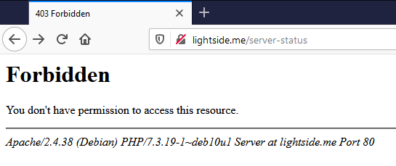
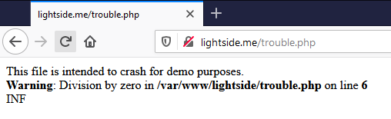
More technical information disclosures…
HTTP-Header
Error messages

Slide 39
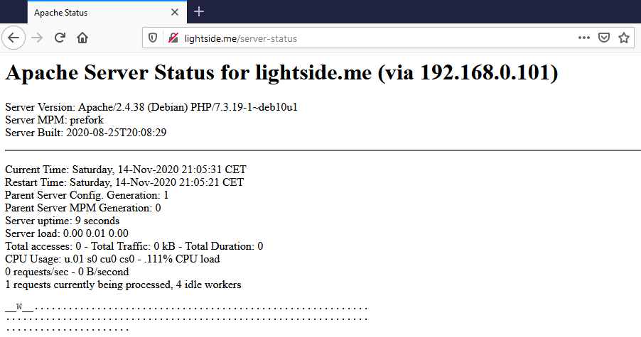
More technical information disclosures…
HTTP-Header
Error messages
Status pages

Slide 40
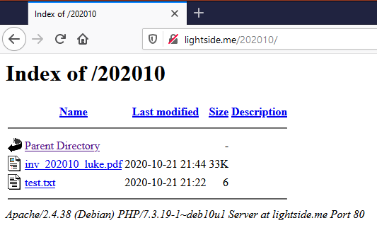
More technical information disclosures…
HTTP-Header
Error messages
Status pages
Directory listings
unreferenced files
e.g. backups, configs etc.

Slide 41
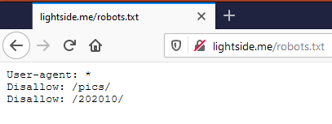
More technical information disclosures…
HTTP-Header
Error messages
Status pages
Directory listings
unreferenced files
e.g. backups, configs etc.
robots.txt
…

Slide 42
Information Disclosure | SQL Injection
Goal | Gather useful information – either for direct use or for further attacks.
How | two categories: - technical data - e.g. HTTP Header, unhandled errors, status, directory index, robots.txt - business data - authorization problems, SQLi, etc. – we will talk about that later
Solution | Webserver configuration hardening Error-Handling Secure Coding
OWASP Top 10
(Primary) Violated Principle

Slide 43
Information Disclosure | SQL Injection
Goal | Gather useful information – either for direct use or for further attacks.
How | two categories: - technical data - e.g. HTTP Header, unhandled errors, status, directory index, robots.txt - business data - authorization problems, SQLi, etc. – we will talk about that later
Solution | Webserver configuration hardening Error-Handling Secure Coding
OWASP Top 10 | A6:2017-Security Misconfiguration A3:2017-Sensitive Data Exposure
(Primary) Violated Principle

Slide 44
Information Disclosure | SQL Injection
Goal | Gather useful information – either for direct use or for further attacks.
How | two categories: - technical data - e.g. HTTP Header, unhandled errors, status, directory index, robots.txt - business data - authorization problems, SQLi, etc. – we will talk about that later
Solution | Webserver configuration hardening Error-Handling Secure Coding
OWASP Top 10 | A6:2017-Security Misconfiguration A3:2017-Sensitive Data Exposure
(Primary) Violated Principle | „Identify sensitive data and how they should be handled.“

Slide 46
http://example.com:8080/demos/demo1.html?id=123&name=Luke#ref1
Versions <= HTTP/2 are plaintext by default

Slide 47
Plaintext Transmission (Info-Discl.) | SQL Injection
Goal | Read or modify data in transit
How
Solution
OWASP Top 10
(Primary) Violated Principle

Slide 48
Plaintext Transmission (Info-Discl.) | SQL Injection
Goal | Read or modify data in transit
How | MitM between client and server - ARP Spoofing in your network (WIFI) or the servers' network - Malicious ISP (employee) - Gateways to foreign countries - DNS Hijacking - …
Solution
OWASP Top 10
(Primary) Violated Principle

Slide 49
Plaintext Transmission (Info-Discl.) | SQL Injection
Goal | Read or modify data in transit
How | MitM between client and server - ARP Spoofing in your network (WIFI) or the servers' network - Malicious ISP (employee) - Gateways to foreign countries - DNS Hijacking - …
Solution | HTTPS (HTTP + SSL/TLS) HTTP/3 uses TLS 1.3 by default
OWASP Top 10
(Primary) Violated Principle

Slide 50
Plaintext Transmission (Info-Discl.) | SQL Injection
Goal | Read or modify data in transit
How | MitM between client and server - ARP Spoofing in your network (WIFI) or the servers' network - Malicious ISP (employee) - Gateways to foreign countries - DNS Hijacking - …
Solution | HTTPS (HTTP + SSL/TLS) HTTP/3 uses TLS 1.3 by default
OWASP Top 10 | A3:2017-Sensitive Data Exposure
(Primary) Violated Principle

Slide 51
Plaintext Transmission (Info-Discl.) | SQL Injection
Goal | Read or modify data in transit
How | MitM between client and server - ARP Spoofing in your network (WIFI) or the servers' network - Malicious ISP (employee) - Gateways to foreign countries - DNS Hijacking - …
Solution | HTTPS (HTTP + SSL/TLS) HTTP/3 uses TLS 1.3 by default
OWASP Top 10 | A3:2017-Sensitive Data Exposure
(Primary) Violated Principle | „Earn or give, but never assume, trust. “

Slide 52
Transport Layer Security (TLS)
TLS = successor of SSL (Secure Socket Layer)
SSL 1.0 ~ 1994/1995
…
TLS 1.3 ~ 2018
Family of multiple protocols
Handshake, Change Cipher Spec., Alert, Application Data, Record
Builds an authenticated encrypted tunnel
Authenticates the accessed website (at least)
Protects the confidentiality and integrity of the data in transfer
HTTP over TLS = HTTPS (port 443 for https://)
PKI needed
Chain of trust ( > 1000 CAs & Intermediate CAs )
HTTPS usage: https://transparencyreport.google.com/https/overview
Notes:
Notiz für Zukunft: da TLS mittlerweile ein integraler Bestandteil des Webs ist könnte man es auch schon davor beim Verbindungsaufbau beschreiben.
https://transparencyreport.google.com/https/overview

Slide 53
PFS – Perfect Forward Secrecy
long-term secret is just used for authentication of session specific Diffie-Hellman Key Exchange
previous sessions cannot be decrypted, even if
one of the old session keys is compromised
the long-term secret (server’s private key) is compromised
most current TLS cipher suites implement PFS today

Slide 54
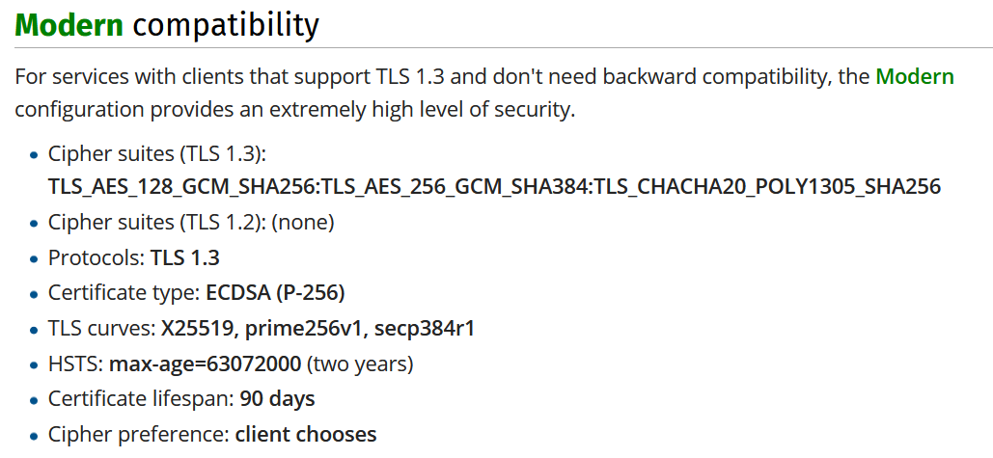
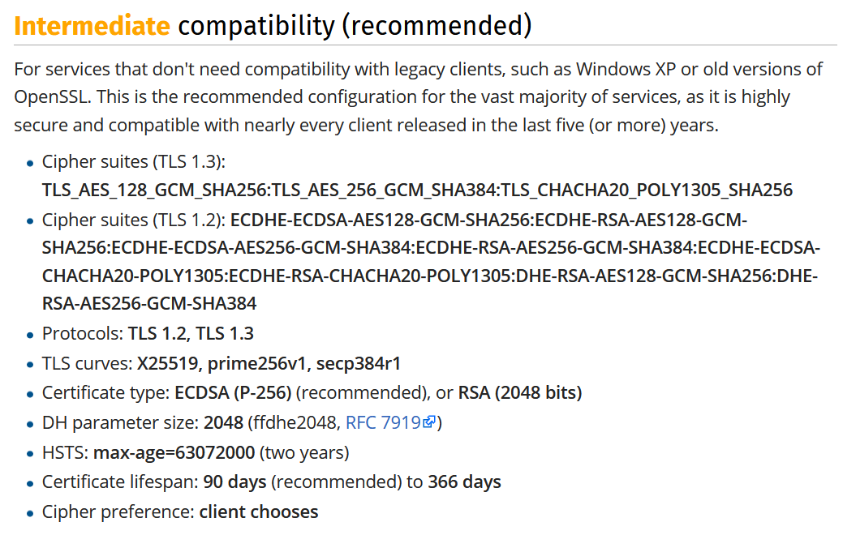
TLS – Avoid common pitfalls
Make sure you only allow
up to date protocols (TLS 1.2 & TLS 1.3)
strong cipher suites
Of course conflicts with browser compatibility
some resources can help you defining appropriate configs
e.g. https://wiki.mozilla.org/Security/Server_Side_TLS

Slide 55
TLS – Avoid common pitfalls
deliver all your content via HTTPS only
it can compromise your whole security if some parts/methods/etc. are available via plain HTTP
(TLS Strip)

Slide 56
HSTS – HTTP Strict Transport Security
Tells the browser to always use HTTPS for this site
e.g. for one year:
Strict-Transport-Security: max-age=31536000
Of course, first visit is still not secure
possible solution: HSTS Preload list
Strict-Transport-Security: max-age=31536000; includeSubDomains; preload
https://hstspreload.org/

Slide 57
Internet Protocol Suite (TCP/IP Model)
ISO/OSI Model
Application
HTTP Req / Resp
TLS
Presentation
Application Layer
Session
TCP, UDP, etc.
Transport
Transport Layer
IP
Network
Internet Layer
Data Link
Ethernet, WLAN, etc.
Link Layer
Pyhsical
Notes:
QUIZ: TLS
Wikipedia: TLS and SSL do not fit neatly into any single layer of the OSI model or the TCP/IP model.^{[8][9]} TLS runs "on top of some reliable transport protocol (e.g., TCP),"^{[10]} which would imply that it is above the transport layer. It serves encryption to higher layers, which is normally the function of the presentation layer. However, applications generally use TLS as if it were a transport layer,^{[8][9]} even though applications using TLS must actively control initiating TLS handshakes and handling of exchanged authentication certificates.^{[10]}

Slide 59






HTML only
HTML + CSS
HTML + CSS + JS
gives you building blocks
and a basic structure
makes it „pretty“
party hard!

Slide 60
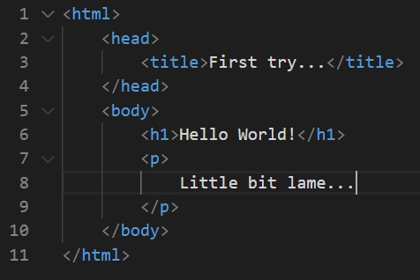
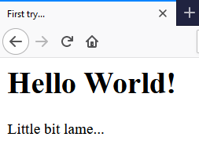

Slide 61
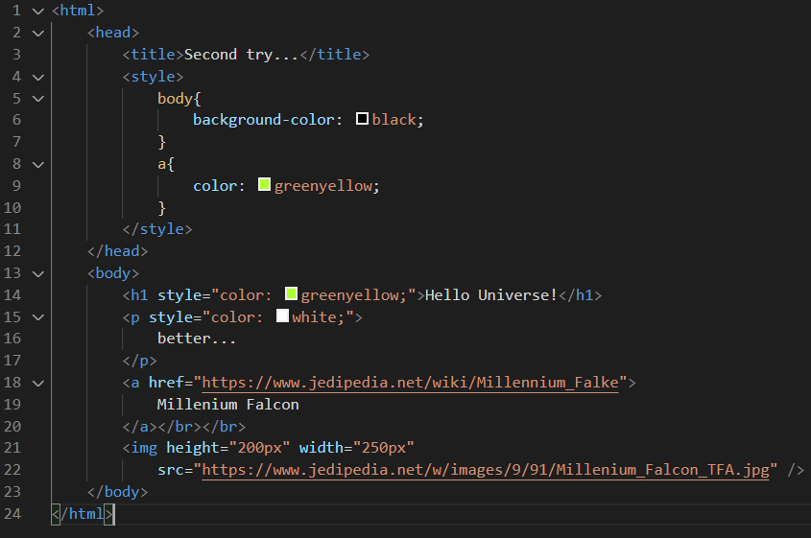
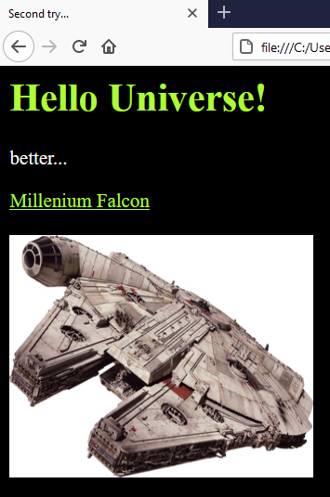

Slide 62
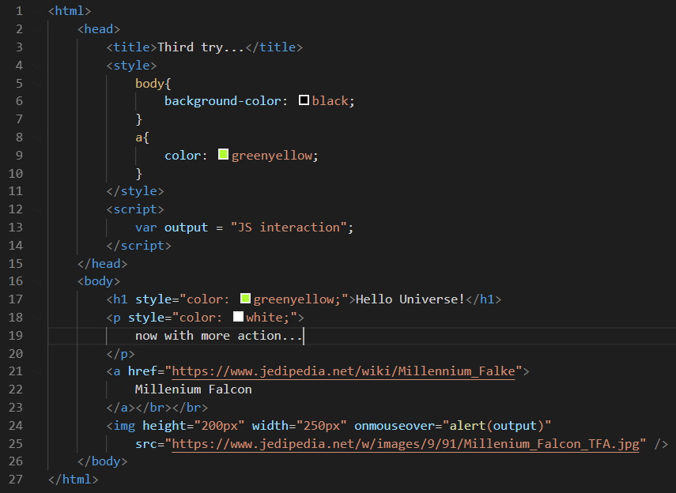
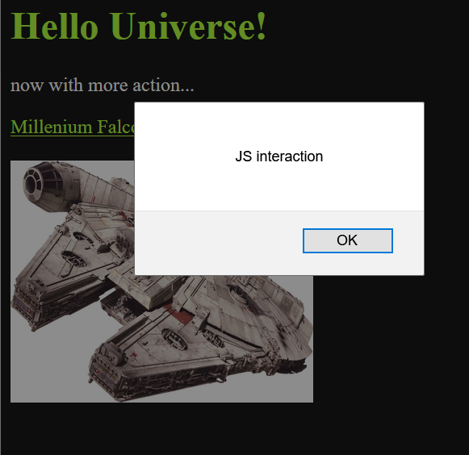

Slide 63
Document Object Model (DOM)
Interface to treat a HTML/XML document as a tree with objects as it’s nodes
Browser constructs a DOM-Tree of the loaded HTML
JavaScript can interact with these DOM-Objects through a defined DOM-Interface

Slide 64
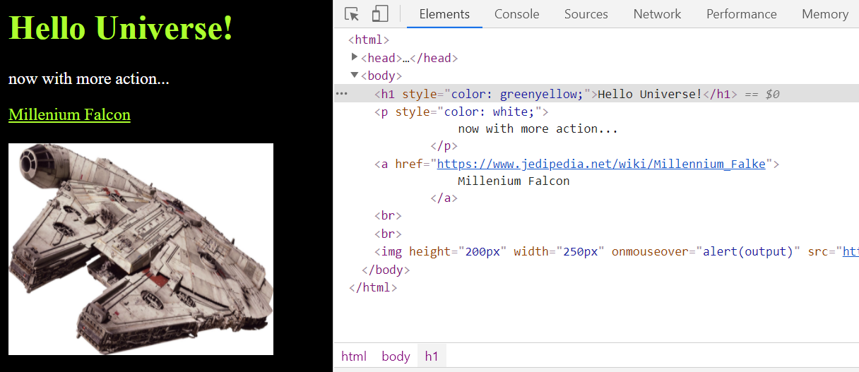
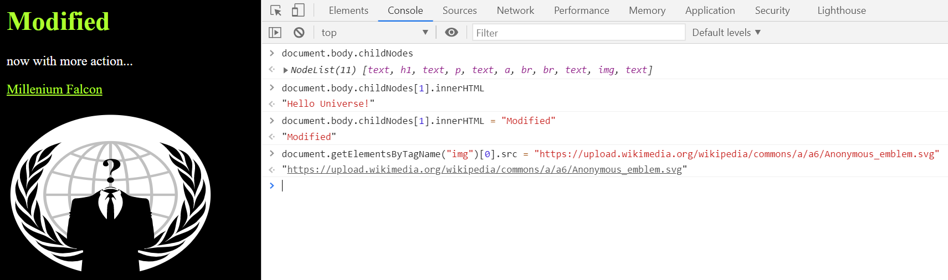

Slide 65
Key messages
Make sure you have control over all your subdomains
Harden your webserver and TLS configuration properly
HTTP is a stateless application-layer protocol based on requests and responses

Slide 66
Is it clear now what happens if you type in a URL and press enter?

Slide 67
Recommended Reading
Architecture of web applications (german only):
https://snikt.net/WebSec.pdf - Chapter 6.1
DNS & HTTP & TLS:
https://web.stanford.edu/class/cs253/
Lecture 01 & Lecture 02 & Lecture 11

